Slide 1
Using Night Light as economic indicator
Nihar Nandan Hemantha Kumara

Slide 2
Overview
Night-light data which provides a numerical measure of brightness of the earth during the night, is a direct result of human activities
hold potential in economic analysis
Literature review and empirical paper
Good amount of research has been done on using night light as economic indicator especially in developing countries
Research Question – Is night light a reliable indicator for economic growth in India.
Data - light data from The India Lights project api from the University of Michigan.
nightlights.io

Slide 3
Overview contd.
Previous work mostly uses simple regression models to estimate the relationship.
This research will focus on trying to use more advanced statistical models (non-linear estimation, quantile regression) to develop a relationship.
Past research also doesn’t account for the impact of informal economies on local growth.
More than 80% of the Indian economy is unorganized
Check whether there is a relationship between different sectors becoming organized is related to increase in urbanization.
If time permits, try to model the expansion of growth based on night light with urban settlements at the center of growth.
Would also like to study the relationship during COVID but there’s no data available.

Slide 4
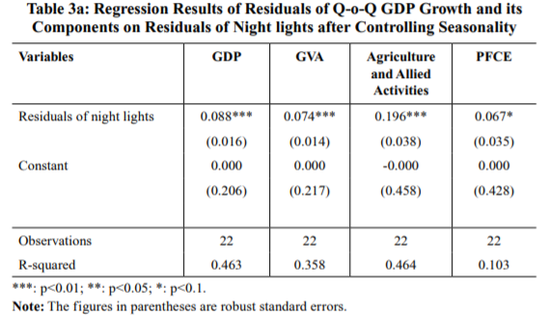
Past regression models
Night-time Luminosity: Does it Brighten Understanding of Economic Activity in India? (Anupam Prakash, Avdhesh Kumar Shukla, Chaitali Bhowmick, Robert Carl Michael Beyer)

Slide 5
About dataset
Field | Type | Description
quintile1-4 |  | Quintile values for the median
result | Object[] | Time series data
key | String | Identifier of geographical area
year | Number | Year of measurement
month | Number | Month of measurement
satellite | String | Satellite that took measurement
count | Number | Number of measurements in this month
Luminosity/vis_median | Number | Average median of measurements for this month
GDP values from World Bank and Department of Economics and Statistics of India.

Slide 6
References
Night-time Luminosity: Does it Brighten Understanding of Economic Activity in India? (Anupam Prakash, Avdhesh Kumar Shukla, Chaitali Bhowmick, Robert Carl Michael Beyer)
Night Lights and Economic Activity in India: A study using DMSP-OLS night time images (Laveesh Bhandari, Koel Roychowdhury )
Nighttime lights as a proxy for human development at the local level (Anna Bruederle, Roland Hodler)
Illuminating Economic Growth (Yingyao Hu and Jiaxiong Yao)
MEASURING ECONOMIC GROWTH FROM OUTER SPACE (J. Vernon Henderson, Adam Storeygard, and David N. Weil)
Measuring Economic Growth from Outer Space (Henderson, J. Vernon; Storeygard, Adam; and Weil, David N.)
Understanding the Impact of Windstorms on Economic Activity from Night Lights in Central America (Oscar A. Ishizawa, Juan Jose Miranda, Hongrui Zhang)

